Slide 1

Funding demystified
A workshop for
application writing

Slide 2
Breaking the Ice exercise
What media and materials do you use in your work and why?
What are the themes that you express in your artistic work?
What is the meaning of your artistic work in your context?
What are the key moments of your artistic story that have led you to this moment?
What has been your experience applying for funding up until now?

Slide 3
Block 1:
Mapping the Local

Slide 4
1.1 Who are the funders?
Public | Fill in before or during workshop session
Private
Corporate
International
Useful platforms

Slide 5
1.2 What do they do?
Name | Scope | Eligibility criteria | Individuals or organisations | Form of support
Fill in before or during workshop session

Slide 6
1.3 What are they like?
Name | Procedures | Language | Working style
Fill in before or during workshop session

Slide 7
1.4 Additional useful information
Gather points of additional information on navigating bureaucracy here, before or during workshop session

Slide 8
Block 2:
Results Frameworks

Slide 9
Block 2 covers:
Describing a plan using activities, outputs, outcomes and impact
Explanation of why this structure is useful
Examples to create a deeper understanding
Thinking about your assumptions
Adapting your results framework to meet the focus of an opportunity
Indicators and sources of information

Slide 10
2.1 Introducing the Framework
Application forms require a particular way of thinking about a project plan
Results framework helps figure out what information to include
Create the building blocks of the story you will tell
Even if the application form doesn’t use these terms, this exercise is good preparation for filling it in

Slide 11
2.1 Introducing the Framework
 | Summary​ | Assumption | ​Indicators​ | ​Source​
​Activity​
​Output
​Outcome​
​Impact​

Slide 12
2.2 Four levels
 | Summary
​Activity​ | What will you be doing?
​Output | What will you have when you’ve done it?
​Outcome​ | What do you expect to happen once you’ve done it?
​Impact​ | What is all of this for?

Slide 13
2.2 Four levels: Activities
The activities of your project are what you will literally be doing if you get the funding
Very practical answer to the most basic question: “What do you want to do as part of this project?”
Not every detail, but the broad tasks and steps for each stage of the project

Slide 14
2.2 Four levels: Outputs
The outputs of your project are what you will put out into the world
This will be the final product of the funding, whether that is an artwork, a performance, an exhibition etc
Might be harder to define for experimental work
Important to describe as much as possible to give the person reading a tangible mental picture of the project

Slide 15
2.2 Four levels: Outcomes
The outcomes you expect to see from your project the (good) things that will result from your outputs being produced
They are a description of the direct results of your outputs in the short to medium term
The effect you want to have on immediate audiences and environments

Slide 16
2.2 Four levels: Impact
The impact you want your project to have is a longer-term change that you want to see in society
It is the solution to whatever problem is motivating you
The impact is not something you will achieve on your own, it is a bigger change that you hope to be part of
Defining an impact helps the person reading to understand why your project is important

Slide 17
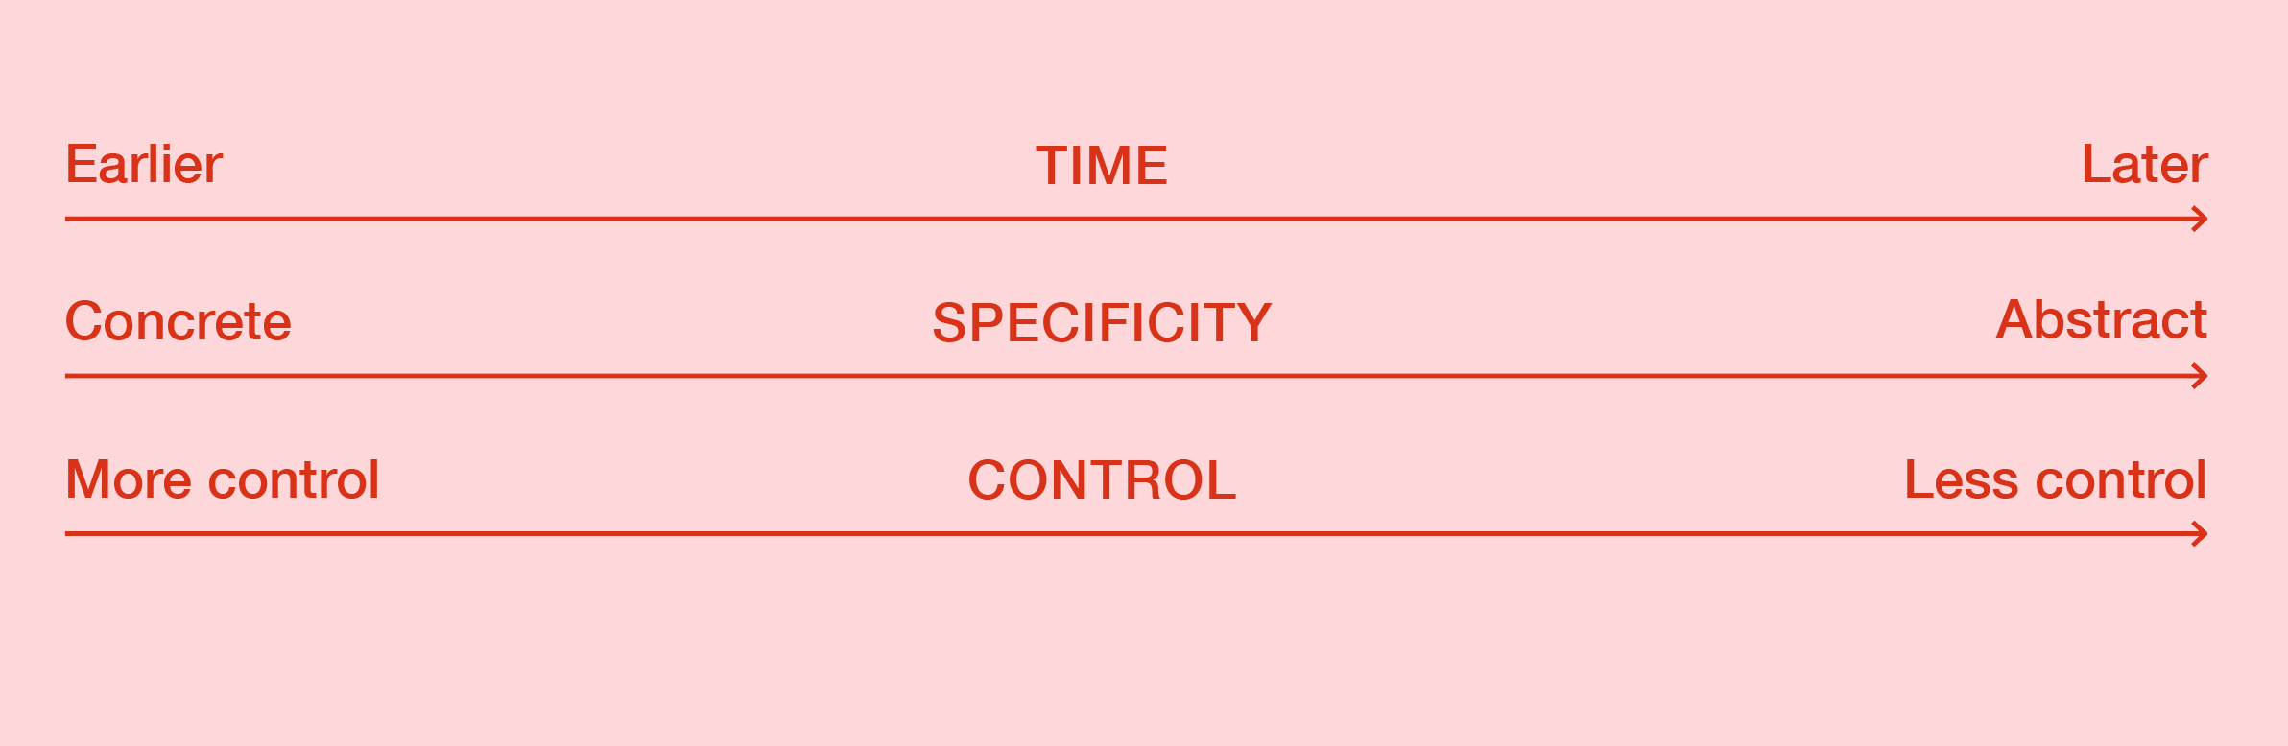
2.3 Progressions

Slide 18
2.4 Abstraction
A project described this way is an abstraction
Artistic work doesn’t divide into tidy boxes like this, real life is always messier
There can be multiple ways to describe the same project
Can use this to your advantage while writing an application

Slide 19
2.5 Two examples
​Activity​ | Fundraising workshop for artists without (much) experience applying for Grants
​Output | Around 50 artists have participated in the fundraising workshop and have a stronger understanding of how to apply for a grant to support an artistic project
​Outcome​ | Artists who participated are more likely to apply for and receive grants for their artistic projects
​Impact​ | There is more accessibility to resources for artists, and resources are distributed more fairly

Slide 20
2.5 Two examples
​Activity​ | Exhibition of work by young artists relating to the environment. During the exhibition there will be a series of workshops bringing together different local voices to tell their stories about the effects of climate change
​Output | At least 100 people of different ages from the local area have participated in workshops and talks, and at least 10 participating artists have shown their work
​Outcome​ | Nuanced and locally rooted discussions about the impact of climate change on the lives of people in the area. People feel empowered to speak up and demand more sustainable policies
​Impact​ | Local citizens have a stronger voice in fighting climate change, more sustainable policies implemented

Slide 21
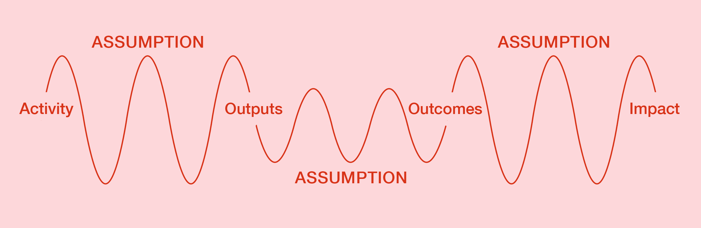
2.6 Assumptions
The jumps between levels need to be realistic – think about what you assume

Slide 22
2.6 Assumptions
 | Summary | Assumptions
Activity | Fundraising workshop for artists without much experience applying for grants | Planned time and location of workshop are convenient for target group to attend Workshop content is aligned with needs of participating artists
Output | Around 50 artists have participated in the fundraising workshop and have a stronger understanding of how to apply for a grant to support an artistic project
 |  | Participants are able to put the skills into practice following the workshop
Outcome | Participants are more likely to apply for and receive grants for their artistic projects
 |  | Lack of technical application-writing skills is a major factor in the lack of equal access to grants
Impact | Improved access to grants for artists without much prior experience

Slide 23
2.6 Assumptions
 | Summary | Assumptions
Activity | Exhibition of work by young artists relating to the environment. During the exhibition there will be a series of workshops bringing together different local voices to tell their stories about the effects of climate change | A wide section of local public are interested in sharing their stories regarding local impact of climate change enough to attend
Output | At least 100 people of different ages from the local area have participated in workshops and talks, and at least 10 participating artists have shown their work locally
 |  | Bringing together different stories and voices allows people to deepen and strengthen their commitment to climate justice
Outcome | Nuanced and locally rooted discussions about the impact of climate change on the lives of people in the area. People feel empowered to speak up and demand more sustainable policies
 |  | There is space in the local political landscape for empowered voices to make a difference
Impact | Local citizens have a stronger voice in fighting climate change, more sustainable policies implemented

Slide 24
2.7 Being Strategic
What you write can be tailored to match the focus of the funding opportunity… up to a point
 | Original idea | Focus on “Capacity Building” | Pushing it too far
Outcome | Participants are more likely to apply for and receive grants for their artistic projects | Participating artists have a better capacity for planning and implementation of stronger projects. | Participating artists will feel less anxiety about money, and so will have better mental health

Slide 25
2.8 Indicators & sources
Indicators are what you observe to see how you did
Sources are the ways you make the observation
 | Summary​ | ​Indicators​ | ​Source​
​Output | Around 50 artists have participated in the fundraising workshop and have a stronger understanding of how to apply for a grant to support an artistic project | % of participants report a clearer understanding of how to apply for a grant | Compare surveys before and after the workshop
Outcome | Artists who participated are more likely to apply for and receive grants for their artistic projects | % of participants successfully applying for grants in the year after the workshop | Survey one year after the workshop

Slide 26
Practice exercise: Results Frameworks
Get into teams of 4 or 5 people. Take turns explaining a project idea to your group, then pick one idea.
Write down in one sentence: at least one activity, output and outcome, and the impact these contribute to. Be as concrete as possible​.
If you have time, try to identify some assumptions you are making that would have to be true for the output to lead to the outcome.

Slide 27
Block 3: Writing

Slide 28
Block 3 covers:
The application form as a text
Clarity as the key need for a strong application
Acknowledging and using the arbitrariness in this approach
Adapting language to different funders

Slide 29
3.1 Thinking about application forms
Application forms vary in how strict or open they are
May tell you something about what the funder will be like to work with
A clear structure makes it easier for the person reading to absorb a lot of information
Read carefully and answer the questions that are there

Slide 30
3.2 Clarity
The biggest issue we have seen in applications from otherwise strong applicants is lack of clarity
Many talented but inexperienced artists are rejected because their application doesn’t show their project clearly
Especially artists with a long-term idea or an experimental approach can find this difficult

Slide 31
3.3 Information
An application can be unclear because it:
Doesn’t have enough information
Has too much information (making it hard to pick out the key points)
Has the right amount of information, but in the wrong order
A combination of the above

Slide 32
3.4 Telling the story
People often write proposals that mirror their thinking process, telling the story of how they got to the point of making an application
This kind of application talks more about context and the why, to communicate how the person writing sees the project
This comes at the expense of concrete details (who, what, where, when…)

Slide 33
3.5 What not to do
Question: Short description of the project for which funding is sought (max. 100 words)
This is a long-term project rooted deeply in the interest in literature as a platform for social emancipation towards solidarity with all forms of life.
Since 2017, this project has been evolving around our attempt to document an ecosystem of alternative literature productive in our city and others. The story about the marginalisation of non-hegemonic writers reflects a shift in paradigm, and the initiatives and time taken recently by young people organizing around independent publishing.
The goal is to emphasise the need for solidarity in today’s individualistic societies. For this next phase of the ongoing project, a production of a publication is envisioned based on the voices and stories we gather from the community. The text will bring together all the separate steps taken so far in this developing story in a coherent form, thus the message of solidarity might reach a wider audience and achieve a stronger impact.

Slide 34
3.6 Doing it better
Question: Short description of the project for which funding is sought (max. 100 words)
The project will consist of an ethnographic field trip, during which we will interview individuals, collectives, and spaces active in independent publishing activities in four key cities in Mexico.
Based on these interviews, which will build on around five years of prior research, we will produce a book bringing together the politics and tactics of independent publishing and the radical ideas associated with it. With it, we will reach a generation of young readers who have not been exposed to publishing outside the mainstream, provoking anti-hegemonic modes of thought and a more diverse public sphere in the country.

Slide 35
3.7 Making it work for you
In the early stages, being so definite can feel arbitrary
The abstraction of the results framework can help you identify concrete information to share
Let the arbitrariness work for you by aligning your outcomes and impact with their mission
When you don’t know yet what something will become, think about how you will find out

Slide 36
3.8 Adapting the language to the type of funder
Information and language you use can also be adapted depending on the type of funder
Big or small, local or international, focussed or general
Context, the significance of certain names or concepts a person needs to know to understand your project
How much is the person reading likely to know already, and how much do you need to tell them?

Slide 37
Practice exercise: Writing
Get back into your teams and look back at your results framework.
Now answer in a way that includes all the information contained in your results framework: Short description of the project for which funding is sought (max. 100 words)
Put your most important point at the beginning
Use short sentences
Avoid jargon

Slide 38
Block 4: Budgets

Slide 39
Block 4 covers:
Preparing a basic project budget
How budgets can reinforce the story you are telling
Thinking about salaries
How much detail a budget should contain
Grouping costs into budget lines
Managing deviations from a planned budget

Slide 40
4.1 What is a budget for?
Your budget is a statement of everything you need that costs money
Budgets are part of telling the story
Reader should be able to guess your activities and outputs just from the budget
A clear budget also shows you know what you’re doing

Slide 41
4.2 What should it look like?
Application form may include budget template to fill in
Complexity of the budget depends on the project scale
Larger, multi-year projects might need multiple sub-totals and detailed planning
For a smaller project, budgets that are overcomplicated become hard to read

Slide 42
4.3 The size of your budget
Funders will say the size of grants they want to give
Since funding and staff hours are fixed in advance, asking for less won’t increase your chances
The total amount you are asking for should be reasonable for your activities
If you roughly know your budget before you start looking for funds, you can pick the right opportunities

Slide 43
4.4 Starting your budget
Think first about what things you will need that cost money.
For example, equipment, travel, venue, labour
Once you have a list, start trying to estimate what each item costs
Estimate based on your experience, asking friends and colleagues, or looking things up online
Try and be as realistic as you can

Slide 44
4.5 Paying People
You will need to decide how you are going to pay everyone involved
Determine a fair hourly rate for any specialists you want to hire, plus how many hours you’ll need
Figure out how to pay yourself and your collaborators
Artists often underpay themselves to reduce total budget
Know what your labour is worth – budget for salaries based your experience and needs

Slide 45
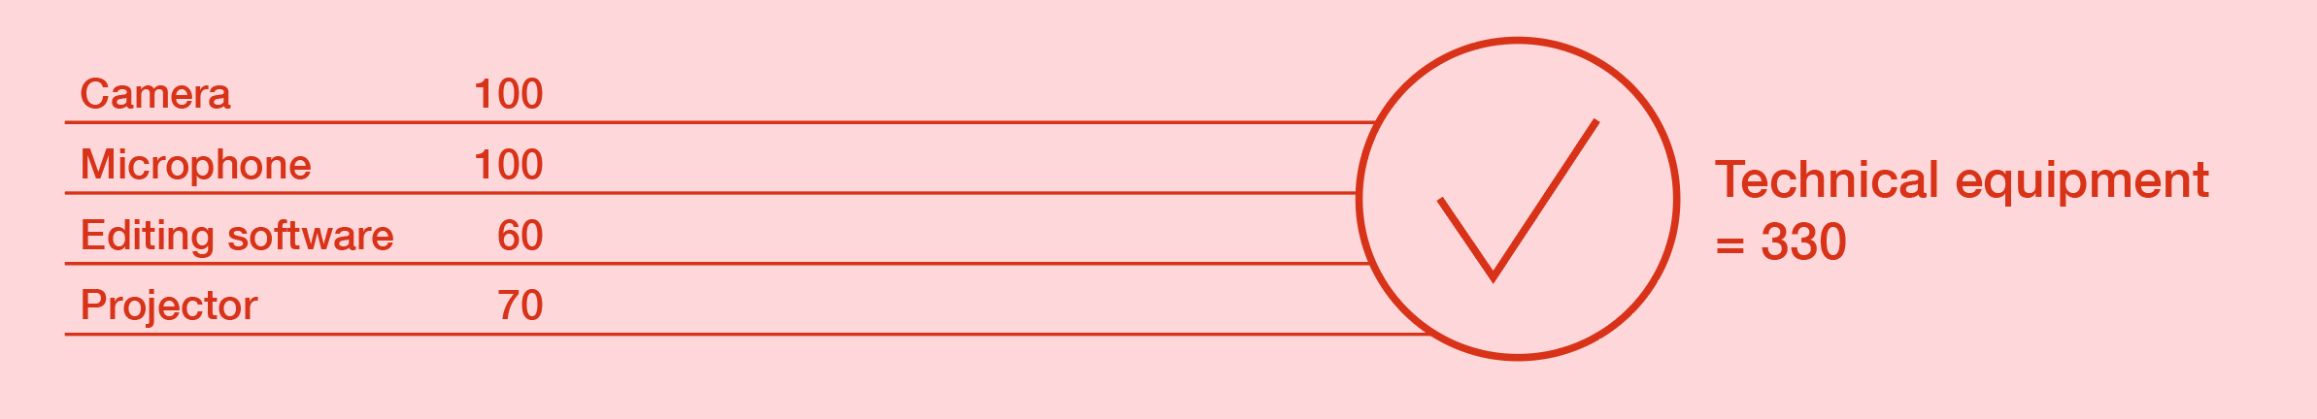
4.6 Budget lines
Individual items are grouped into budget lines. These make the budget easier to read and give you flexibility – it’s easier to change the details within a budget line if you need to.

Slide 46
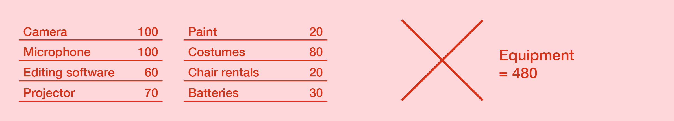
4.6 Budget lines
But budget lines that are too broad get in the way of communicating.

Slide 47
4.7 Funders’ limits
Some funders have restrictions on costs they will cover
For organisations, most common type of restriction is on overhead
Funders may also have restrictions on purchasing items that will be useful beyond the project
Read regulations carefully and write your budget accordingly

Slide 48
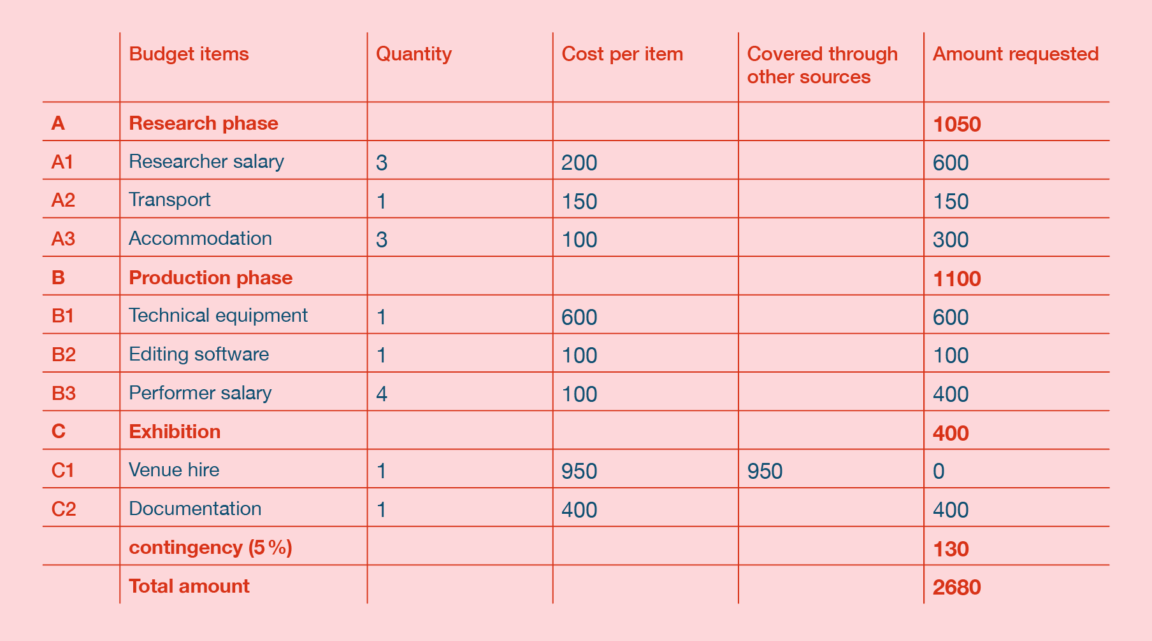
4.8 Organising budget lines: two examples

Slide 49
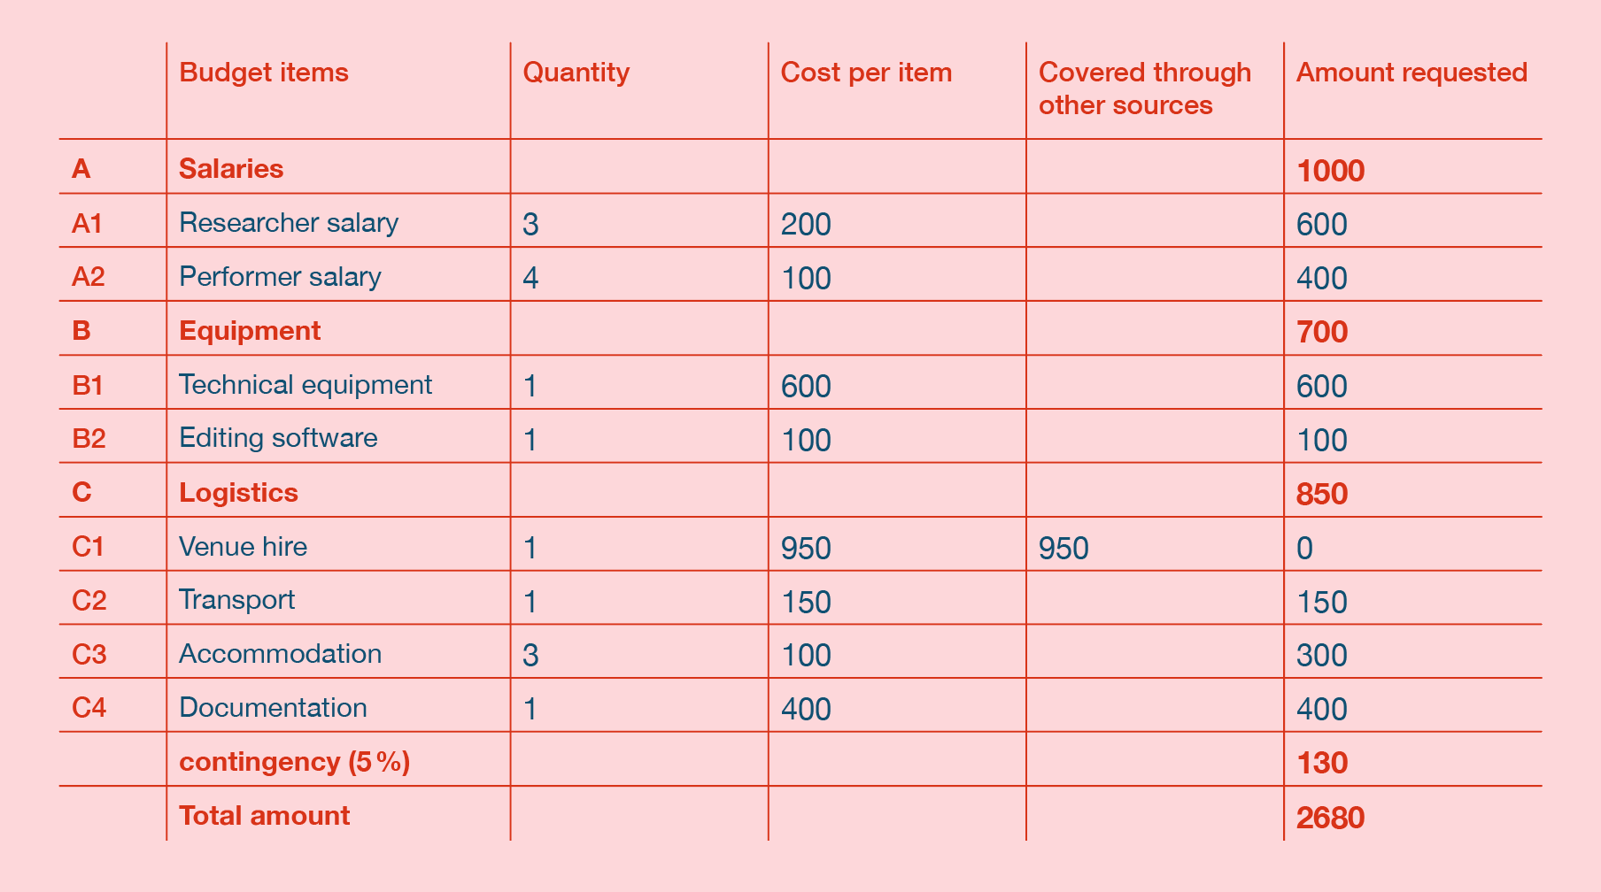
4.8 Organising budget lines: two examples

Slide 50
4.9 Double checking
There can be a lot of small details to check with budgets
With international applications you might have to give the budget in multiple currencies
Using formulas in a spreadsheet for your calculations helps, but tiny mistakes can have big consequences
Ask someone else to do a final check

Slide 51
4.10 Using your budget
Budget will probably be the template for a financial report after your project is done
Keep track of your actual spending using the same budget lines
Real spending will never align in every detail, but deviations should make sense
Inform your funder of major changes

Slide 52
Practice exercise: Budgets
Get back into your teams and look back at the project you’ve planned together so far.
Make an exhaustive list of everything that costs money that you would need to make the project happen
Then try to put them into 3 or 4 groups, either by project phase or by type of cost
If you have time, try to estimate how much you would need to ask for each group of costs

Slide 53
Block 5: Reporting

Slide 54
Block 5 covers:
The purpose of reporting
Using reporting to reflect and learn yourself
Gathering qualitative and quantitative information for your report
Reflective reporting, particularly when projects have not gone as planned

Slide 55
5.1 What is reporting?
Reporting takes place after the project
May also be reporting during the project
It is the official statement of what the actual activities, outputs, outcomes, impact were
Final payment may depend on your report

Slide 56
5.2 Why do you report?
Why do Funders ask for reporting? A couple of reasons:
They’re interested
For reporting to their own donors
To learn and improve

Slide 57
5.3 Reporting forms
You’ll likely report by filling in a standardized form, which you’ll receive in advance
Allows funders to aggregate across multiple projects
Range of approaches to reporting from different funders
Will likely mirror application form

Slide 58
5.4 Results Framework in Reporting
Good reporting helps you understand what you can learn from the project
Like the application, being clear is crucial
Results framework will help you identify the most important information to share
Describe the success of actual activities, outputs, outcomes, impact

Slide 59
5.5 Planning for reporting
Look at the reporting form and start planning early
The indicators in your results framework are a guide to what you should observe and record
Reporting form may ask for specific indicators as well, such as gender balance

Slide 60
5.6 Ways of Observing
You will need to decide what methods are best to observe based on what you want to observe. Some ways might be:
Media Scan
Web statistics
Collecting feedback
Self-reflection
Surveys
Interviews

Slide 61
5.6 Ways of Observing
Make sure that the effort involved is proportional and makes sense for you
Be aware of any duty of care and push back if you need to
Be transparent with anyone whose personal data you are using

Slide 62
5.7 When do you measure?
Plan the moments you will collect information
If you hope to see tangible change in a certain indicator, measure before and after so you have a baseline
If you’re looking for more reflective feedback, wait a little
If you want to see something long term, pick a moment that is doable

Slide 63
5.8 Writing
A good report helps the person reading form a mental picture of the project
Any pictures you can share will also help
Just like the application, answer the questions that are there for ease of reading
Don’t assume detailed knowledge of your project – personnel might have changed!

Slide 64
5.9 Being reflective
Great reports reflect on what was learned through the project
Maybe one of the assumptions was wrong, or something unexpected derailed the project
Being transparent makes a better impression than hiding
Share what went wrong, why, and what you would do differently

Slide 65
5.10 Financial reporting
Your financial report is based on the structure of your budget
Actual spending will never be exactly the same as planned, life is just messy like that
Check funder’s policy on budget deviations and when you need their approval

Slide 66
Practice exercise: Reporting
Back in your teams, look at the project you’ve described so far. Imagine it’s already done and you need to answer the following question:
Give a short summary of the results of your project – what did you achieve, what was the impact? (100 words)
Answer this question in two different ways:
Describing the best-case scenario version of your imagined project; what went well, and how do you know that it went well?
Describing the worst-case scenario version of your imagined project; what went badly, and why do you think it went badly? Is there something you could do differently next time?

Slide 67
Closing exercise
Prioritising being clear is also important when you talk to funders!
Introduce yourself again, making sure to touch on an activity, an output, an outcome and an impact
Weave the information together in a natural, conversational way.

